Slide 1
IBM
Watsonx Studio Project

Slide 2
ACKNOWLEDGEMENT
I would like to express my sincere gratitude to IBM for providing the Watsonx Studio platform.
Special thanks to my mentors, faculty, and peers for their guidance and support.
This project was an enriching learning experience in applied AI and AutoML.

Slide 3
PROJECT OVERVIEW
The IBM Watsonx Studio Project focus on building , training and deploying AI and machine learning models efficiently. It provide tools for preparation , visualization , model management . The project demonstrates how Watsonx Studio enables faster insights , supports collaboration , and promotes responsible AI practices across and informed decision- making.
Watsonx simplifies the entire ML pipeline b authomating data prepation , modal training and deployment. It enables faster insights , seamless collaboration , and responsible AI management across industries.

Slide 4
Background & Objective
Utilize IBM Watsonx Studio ‘s AutoAI to explore housing datasets efficiently
Objective : Estimate housing feactures such as price , area , and number of bathrooms using predictive modeling
Showcase the process of automating machine learning workflows for improved accuracy and faster insights.

Slide 5
Introduction
IBM Watsonx Studio : end –to-end AI lifecycle management tool
Provides data preparation , model training ,deployment , and monitoring in one platform
Auto AI : simplifies data preprocessing algorithm selection , and hyper parameter turning.
Enhances productivity by reducing errors and saving development time

Slide 6
Workflow / Methodology
Import data and perform preprocessing in Watsonx Studio
Use AutoAI to authomatically detect suitable algorithms
Generate multiple model pipelines for comparison
Validate models using test data performance metrics
Deploy the best model for real- world predications

Slide 7
Project Description
Dataset : customer_churn.csv with demographic & usage feactures
AutoAI created different ML pipelines automatically
Algorithms tested included Logistic Regression , Gradient Boosting,SVM,etc.
Pipelines evaluated on precision , recall , and F1-score

Slide 8
Result & Insights
AutoAI explored different algorithms and preprocessing strategies .
Best performing Gradient Boosted Trees Model .
Achieved accuracy – 72.3%.
Visualization highlights top model performance comparison.

Slide 9
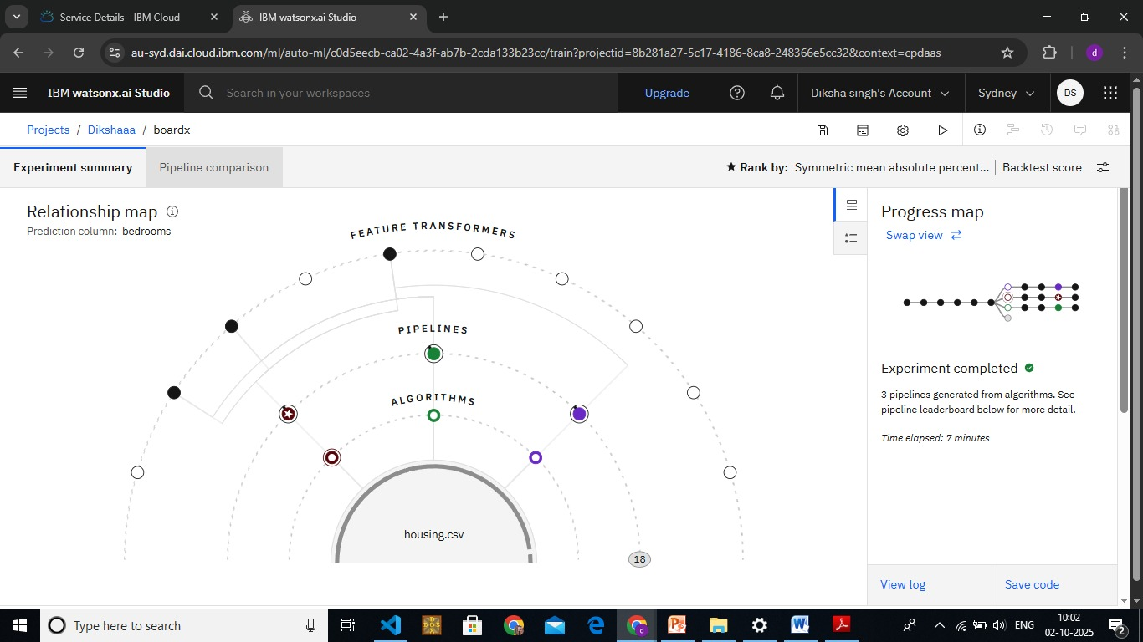

Slide 10
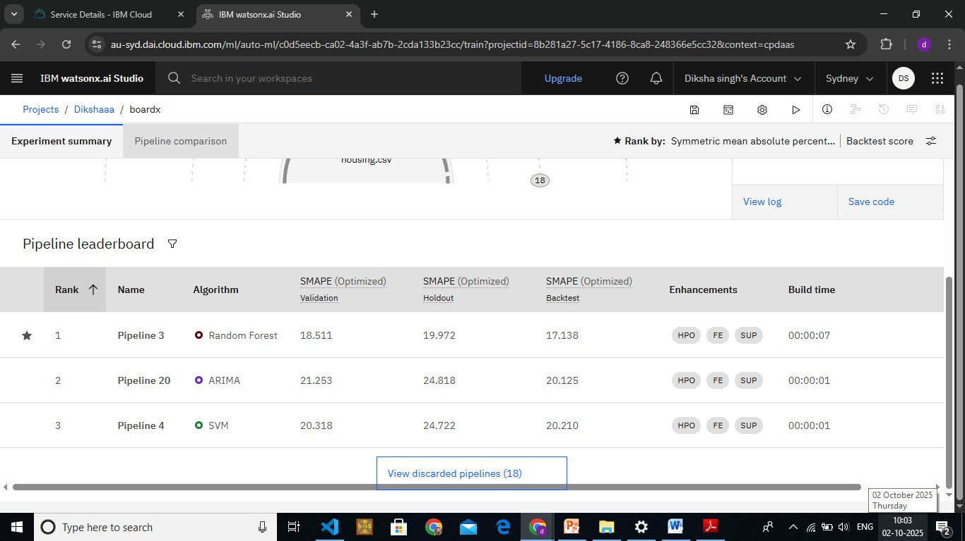

Slide 11
Impact / Benefits
✔ AutoAI highlighted key features contributing most to model accuracy
✔ Evaluation metrics (precision, recall, F1-score) provided deeper performance insights
✔ Scalable for large datasets without extra manual coding
✔ Supports reproducibility by saving pipeline configurations automatically

Slide 12
Challenges Faced
It is hard to handle very large amounts of data.
Making accurate models needs good skills and knowledge.
Cleaning and preparing data takes a lot of time.
Using AI in a fair and safe way is not simple.
Putting models into real use can be costly.

Slide 13
Future Scope
Watsonx can be used in many more fields like finance, education, agriculture, and healthcare.
It can be connected with IoT devices to use real-time data.
Blockchain can be added for secure and transparent data sharing.
More advanced models can be developed for faster and smarter decisions.
It has the potential to make AI more reliable and useful for everyone.

Slide 14
Conclusion
Our project showed how AI and AutoML can make the machine learning process faster, easier, and more accurate.
IBM Watsonx Studio plays a key role by offering tools for data preparation, model training, deployment, and governance in one place.
The project explained challenges, future scope, and real-world uses, proving that Watsonx can save time, reduce cost, and support better decisions.
Overall, Watsonx and AutoML together represent the future of AI, where technology is not only powerful but also responsible and easy to use.

Slide 15
References
IBM Official Website – https://www.ibm.com
IBM Watsonx Documentation & Blogs
Research articles on AI and Machine Learning
Class notes and study material used during project
Guidance from teachers and mentors

